Slide 1
Navigating the Common Core in Rough Water
Some Thoughts from an Old Sailor!!
NYSAMS
Annual Breakfast Meeting
November 13th, 2015
Hyatt Regency – Rochester, NY
Bill Caroscio
bcaroscio@gmail.com

Slide 2
Elem. Algebra
Geometry
Intermediate Algebra
Trigonometry
Advanced Algebra
Course I
Course II
Course III
Math 9
Math 10
Math 11
Algebra
Math A
Geometry
Math B
Intermediate Algebra & Trig
Common Core
Algebra
Geometry
Algebra 2 & Trigonometry

Slide 3
Why the Common Core??
For more than a decade, research studies of mathematics education in high-performing countries have concluded that mathematics education in the United States must become substantially more focused and coherent in order to improve mathematics achievement in this country. To deliver on this promise, the mathematics standards are designed to address the problem of a curriculum that is “a mile wide and an inch deep.”
http://www.corestandards.org/Math/
For more than a decade, research studies of mathematics education in high-performing countries have concluded that mathematics education in the United States must become substantially more focused and coherent in order to improve mathematics achievement in this country. To deliver on this promise, the mathematics standards are designed to address the problem of a curriculum that is “a mile wide and an inch deep.”
http://www.corestandards.org/Math/
Test Scores!
More about this later!

Slide 4
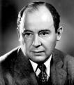
Intimidation
“John von Neumann is the only student of mine I was ever intimidated by. He was so quick. There was a seminar for advanced students in Zurich that I was teaching and von Neumann was in the class. I came to a certain theorem, and I said it is not proved and it may be difficult. Von Neumann didn’t say anything but after five minutes he raised his hand. When I called on him he went to the blackboard and proceeded to write down the proof. After that I was afraid of von Neumann.”
George Polya The Polya Picture Album – Encounter of a Mathematician

Slide 5
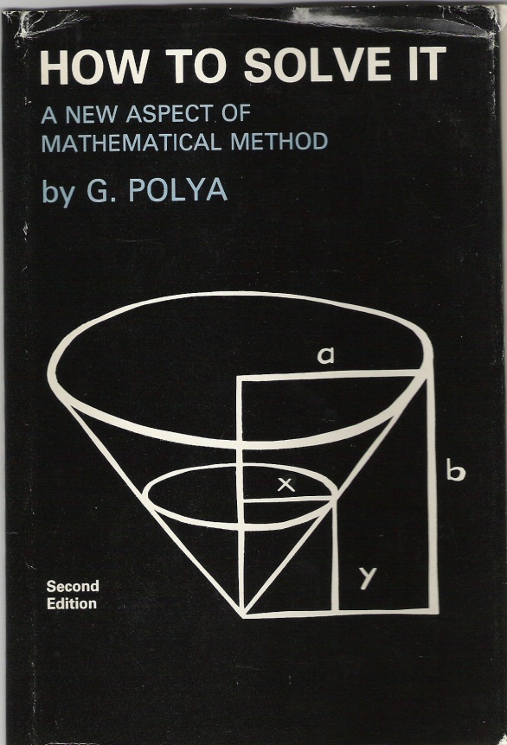
“Little Black Book”!
How to Solve It
George Polya
©1945 by Princeton University Press
©1957 Second Edition
© renewed 1973
Polya’s Heuristic
Understand the problem
Devise a plan
Carry out the plan
Look back

Slide 6
We’ve come a long way baby! Or have we?
Write the equation that would be used in solving the following problems. In each case state what the letter or letters represent [solution of the equations is not required.]
a. A can do a piece of work in 4 hours, and B can do it in 5 hours. A works alone for 1 hour. How long will it take B, working alone, to finish the job?
b. A dairyman wishes to mix milk containing 5% butterfat and cream containing 75% butterfat in such a way that the total mixture of 56 pounds shall contain 50% butterfat. How much of each kind should he use?
Monthly mortgage payments can be found using the formula below:
M = monthly payment
P = amount borrowed
r = annual interest rate
n = number of monthly payments
The Banks family would like to borrow $12000 to purchase a home. They qualified for an annual interest rate of 4.8%. Algebraically determine the fewest number of whole years the Banks family would need to include in the mortgage agreement in order to have a monthly payment of no more than $720.

Slide 7
Solve the following system of equations algebraically for all values of x, y, and z:
Solve for x, y, and z:

Slide 8
Using the formula A = P(1 = r)^{n} , find to the nearest per cent, the rate at which $400 must be invested to amount to $496 in 12 years, interest compounded annually.
Use an appropriate procedure to show that x – 4 is a factor of the function
f(x) = 2x³ – 5x² – 11x -4. Explain your answer.

Slide 9
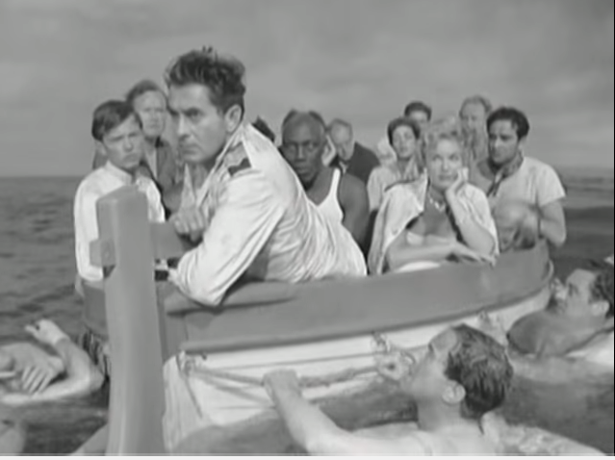
We are presented with an opportunity. Will we sink or swim as we try to implement the CCSS?
“Thus, a teacher of mathematics has a great opportunity. If he fills his allotted time with drilling his students in routine operations he kills their interest, hampers their intellectual development, and misuses his opportunity. But if he challenges the curiosity of his students by setting them problems proportionate to their knowledge, and help them to solve their problems with stimulating questions, he may give them a taste for, and some means of, independent thinking.”
HTSI p. v.
https://www.youtube.com/watch?v=xVm2dbMdXRs
Scene from "Abandon Ship!" / "Seven Waves Away" (1957)
http://www.pbs.org/newshour/bb/will-sink-will-survive-states-test-common-core/

Slide 10
Standards for Mathematical Practice (SMP)
Make sense of problems and persevere in solving them. What is the unknown? What are the data? What is the condition? |  | Use appropriate tools strategically. Use technological tools to explore and deepen understanding of concepts.
Reason abstractly and quantitatively. Make sense of quantities and their relationships. Contextualize and/or Decontextualize. |  | Attend to precision. Communicate precisely to others and calculate accurately and efficiently.
Construct viable arguments and critique the reasoning of others. Make conjectures and build logical progressions. |  | Look for and make use of structure. Look for patterns or structure. Draw auxiliary lines.
Model with mathematics. Write an equation to describe the situation. Use diagrams, tables, graphs, formulas, etc. |  | Look for and express regularity in repeated reasoning. Are calculations repeated? Are there shortcuts?
Understand the problem.
Carry out the Plan.
Devise a Plan.
Look Back.

Slide 11
Life is too short for long division!!
A great discovery solves a great problem but there is a grain of discovery in the solution of any problem. Your problem may be modest; but if it challenges your curiosity and brings into play your inventive faculties, and if you solve it by your own means, you may experience the tension and enjoy the triumph of discovery.
HTSI p. V

Slide 13
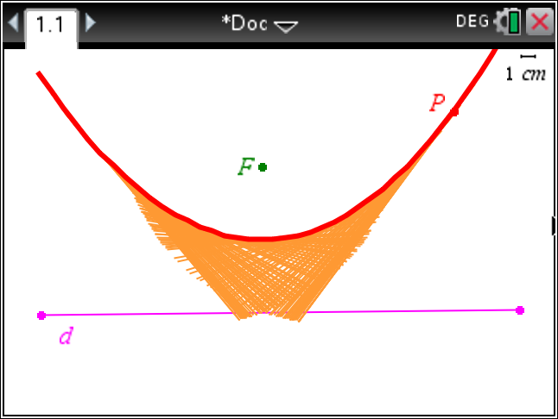
G-GPE.A.2 Derive the equation of a parabola given a focus and directrix.

Slide 14
Life is too short for factoring!!
A-CED.A.1Create equations and inequalities in one variable and use them to solve problems.
F-BF.A.1 Write a function that describes a relationship between two quantities.

Slide 15
The Painted Cube
Imagine you have been given a 10×10×10 cube and that you dip it in a can of paint. How many unit cubes have paint on zero, one, two and three faces?

Slide 16
Life is too short for the quadratic formula!!
How many solutions are there to the following equation?
$$2cos(x)=x^{3}−2x$$
What are they?

Slide 18
Common Core Task Force Public Meeting 1, Westchester - 10/29/15 http://www.ny.gov/events/first-public-session-common-core-task-force

Slide 19
Dr. Louisa Moates nationally-renowned teacher, psychologist, researcher and author, was one of the contributing writers of the Common Core State Standards (CCSS) https://www.psychologytoday.com/blog/child-development-central/201401/when-will-we-ever-learn
“I never imagined when we were drafting standards in 2010 that major financial support would be funneled immediately into the development of standards-related tests. How naive I was. The CCSS represent lofty aspirational goals for students aiming for four year, highly selective colleges. Realistically, at least half, if not the majority, of students are not going to meet those standards as written, although the students deserve to be well prepared for career and work through meaningful and rigorous education.”
“Our lofty standards are appropriate for the most academically able, but what are we going to do for the huge numbers of kids that are going to “fail” the PARCC (Partnership for Assessment of Readiness for College and Careers) test? We need to create a wide range of educational choices and pathways to high school graduation, employment, and citizenship. The Europeans got this right a long time ago.”

Slide 20
Dr. Moates Continues
“If I could take all the money going to the testing companies and reinvest it, I’d focus on the teaching profession – recruitment, pay, work conditions, rigorous and on-going training. Many of our teachers are not qualified or prepared to teach the standards we have written. It doesn’t make sense to ask kids to achieve standards that their teachers have not achieved!”
“Classroom teachers are confused, lacking in training and skills to implement the standards, overstressed, and the victims of misinformed directives from administrators who are not well grounded in reading research. I’m beginning to get messages from very frustrated educators who threw out what was working in favor of a new “CCSS aligned” program, and now find that they don’t have the tools to teach kids how to read and write. Teachers are told to use “grade level” texts, for example; if half the kids are below grade level by definition, what does the teacher do? She has to decide whether to teach “the standard” or teach the kids.”

Slide 21
Impact of CCSS!?
“Since the Common Core standards have never been field-tested, no one knows whether they will raise test scores or cause the achievement gap among different racial, ethnic, and income groups to narrow or to widen. One study, by Tom Loveless of the Brookings Institution, predicted that the standards would have little or no effect on academic achievement; he noted that ‘from 2003 to 2009, states with terrific standards raised their National Assessment of Educational Progress scores by roughly the same margin as states with awful ones.’”
ROE p.91

Slide 22
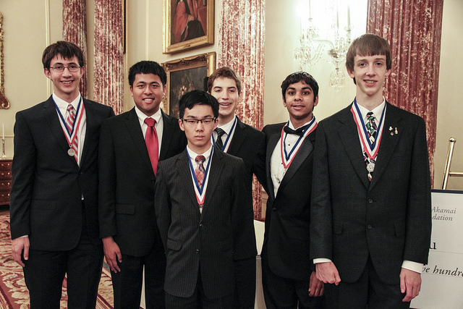
What’s the Good & Bad News?
“Public education is not broken. It is not failing or declining. The diagnosis is wrong, and the solutions of the corporate reformers are wrong. Our urban school are in trouble because of concentrated poverty and racial segregation. But public education as such is not ‘broken’. Public education is in a crisis only so far as society is and only so far as this new narrative of crisis has destabilized it. The solutions proposed by the self-proclaimed reformers have not worked as promised. They have failed even by their own most highly valued measure, which is test cores. At the same time, the reformers’ solutions have had a destructive impact on education as a whole.”
ROE p. 16

Slide 23
Impact of Poverty. Where does the US Rank?
“The most important international comparison of educational performance is the Programme for International Student Assessment, or PISA, a test given every three year to fifteen-year-olds all over the world. Last time out, the U.S. average score was 500, just behind Poland and ahead of Liechtenstein.
However…
If America’s scores were limited to those from schools in districts in which the poverty rate was less than 10 percent – Finland's poverty rate is less than 4 percent – the United States would lead the world, and it wouldn’t be close: 551 on the latest PISA test, compared to Finland's 536, or South Korea’s 539. In fact, if all you did was exclude the American schools that have student bodies that are more than three-quarters poor, U.S. schools would still score 513, just behind Australia, but ahead of the Netherlands, Belgium, Sweden, Germany, Iceland … well, you see the picture.”
IGS p. 8

Slide 24
Final Thoughts
Teachers Matter!!

Slide 25
Role of the Teacher
“One of the most important tasks of the teacher is to help his students. This task is not quite easy; it demands time, practice, devotion, and sound principles. The student should acquire as much experience of independent work as possible. But if he is left alone with his problem without any help or with insufficient help, he may make no progress at all. If the teacher helps too much, nothing is left to the student. The teacher should help, but not too much and not too little, so that he student shall have a reasonable share of the work.”
HTSI p. 1

Slide 26
Impact of Good Teachers
“Economists have studied just how much a teacher is worth, using models that measure things like educational attainment and test scores to ask, ‘How much does an increase in the acquisition of cognitive skill (like analytical reading, or competency in math) add to someone’s lifetime earnings?’ And the answer is a ‘whole bunch.’ One year’s improvement of a quarter of a standard deviation in overall educational achievement generates an average earning increase of $5300; and that means that a teacher who can consistently deliver that sort of improvement is generating about $106000 in incremental income for every class of twenty students she teaches.”
IGS p.82

Slide 27
Caveat!
The study done by Raj Chetty and John N. Friedman of Harvard University was even referred to in President Obama’s State of the Union message. “We know a good teacher can increase the lifetime income of a classroom by over $250000.”
However, critics were quick to raise questions about the study. They said that the authors may have confused correlation with causation (a class that gets higher test scores is also likelier to go to college and earn more) and that a large-scale study cannot pinpoint the effects of individual teachers. More than one critic pointed out that a lifetime gain of $260000 for a class of twenty-six children, engaged in the labor force for forty years, translated to about $250 a year, or $5 a week. As Bruce Baker observed, ‘What this boils down to is that a student can get a lifetime boost of $5 a week if we now spend billions of dollars on value-added rating systems.”
ROE p.212

Slide 28
“Nations such as Finland, Canada, Japan, and South Korea spend time and resources improving the skills of their teachers, not selectively firing them in relation to student test scores.”
ROE p.213

Slide 29
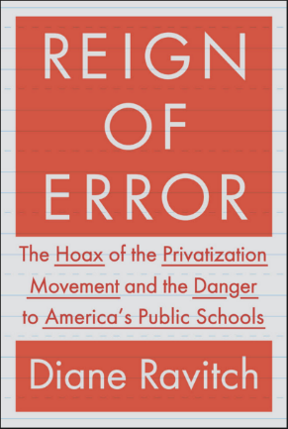
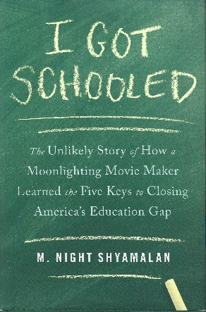
Resources
Polya, George, How To Solve It, Princeton University Press, Princeton, NY, 1945.
Ravitch, Diane, Reign of Error, Alfred A. Knopf, New York, 2013.
Shyamalan, M. Night, I Got Schooled, Simon & Schuster, New York, NY, 2013.

Slide 30
Thank you!
By attending this conference
you are becoming part
of the solution. Keep up the
good work.

